Slide 1
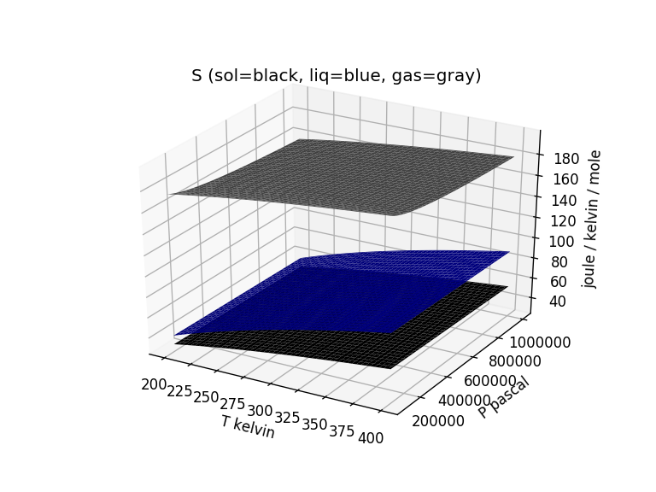
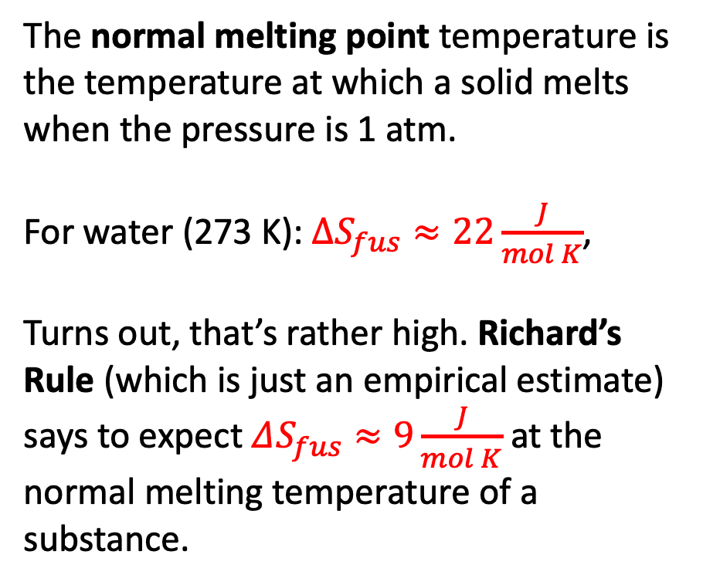
Entropy of fusion: Richard’s Rule
The normal melting point temperature is the temperature at which a solid melts when the pressure is 1 atm.
For water (273 K): $∆S_{fus}≈22\frac{J}{mol K}$,
Turns out, that’s rather high. Richard’s Rule (which is just an empirical estimate) says to expect $ΔS_{fus}≈9\frac{J}{mol K}$ at the normal melting temperature of a substance.

Slide 2
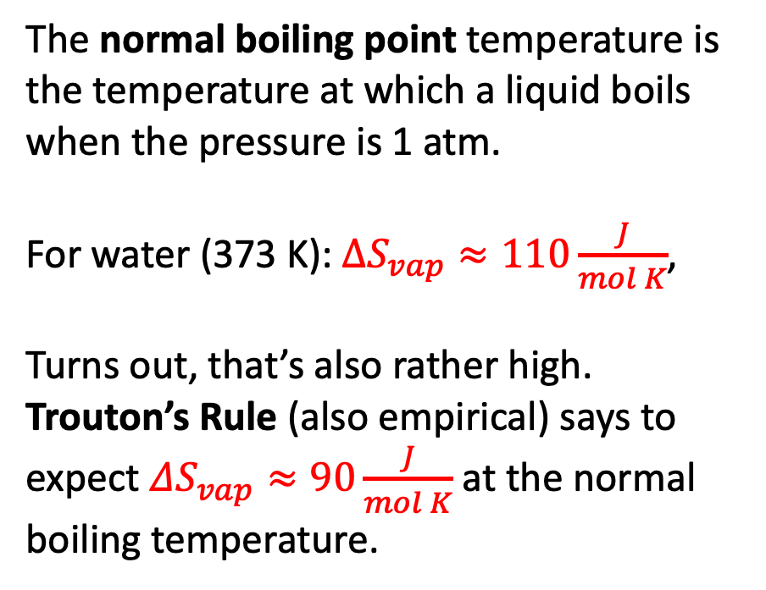
Entropy of fusion: Trouton’s Rule
The normal boiling point temperature is the temperature at which a liquid boils when the pressure is 1 atm.
For water (373 K): $∆S_{vap}≈110\frac{J}{mol K}$,
Turns out, that’s also rather high. Trouton’s Rule (also empirical) says to expect $ΔS_{vap}≈90\frac{J}{mol K}$ at the normal boiling temperature.

Slide 3
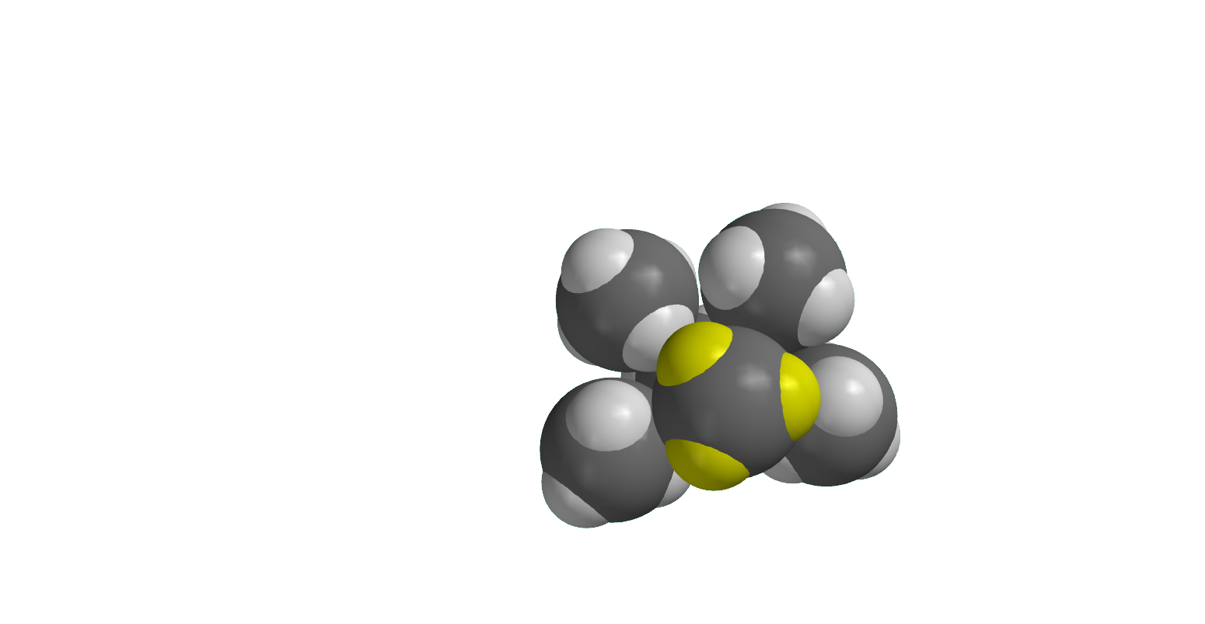
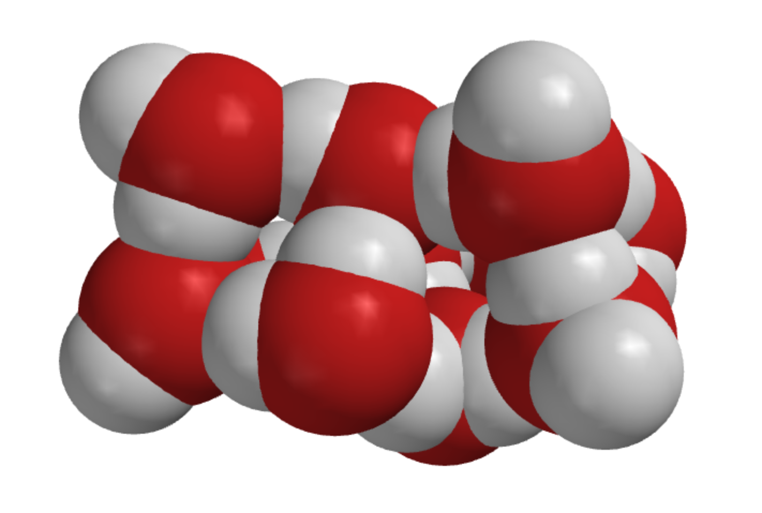
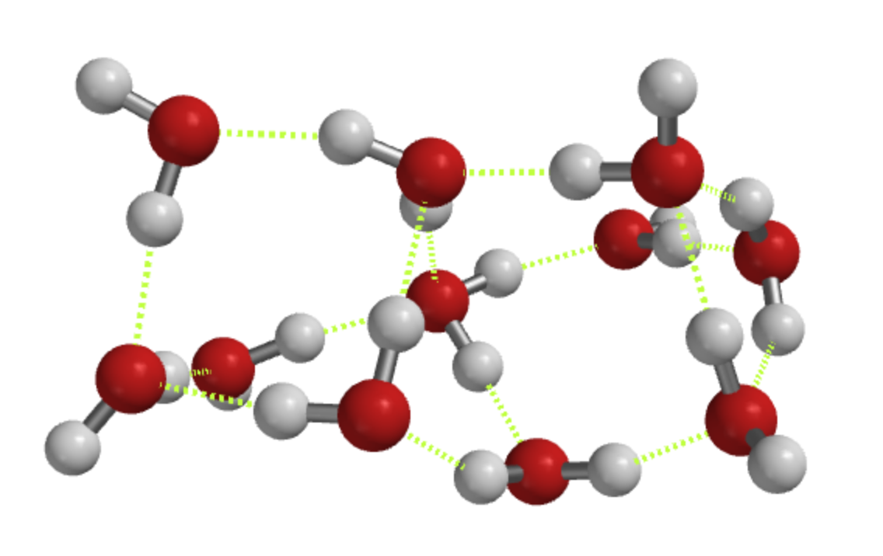
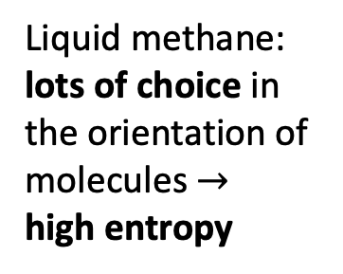

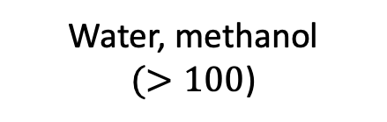
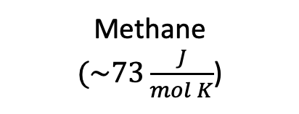
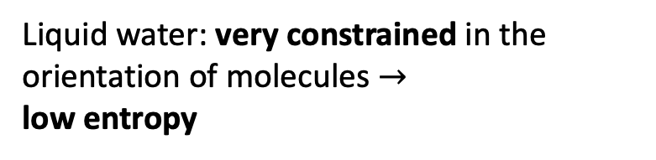
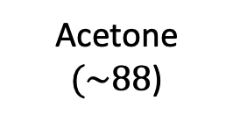
Why $∆S_{vap}$ of water is so big
Methane
$(\sim 73\frac{J}{mol K}$)
Acetone
$(\sim 88$)
Water, methanol
$(>100$)
Liquid water: very constrained in the orientation of molecules $→$
low entropy
Liquid methane: lots of choice in the orientation of molecules $→$
high entropy
Notes:
https://slideplayer.com/slide/7362502/

Slide 4
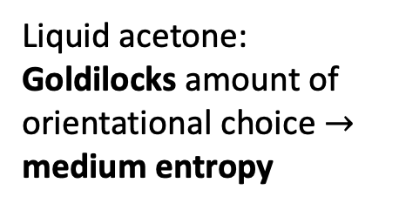
Why $∆S_{vap}$ of water is so big
Methane
$(\sim 73\frac{J}{mol K}$)
Acetone
$(\sim 88$)
Water, methanol
$(>100$)
Liquid water: very constrained in the orientation of molecules $→$
low entropy
Liquid methane: lots of choice in the orientation of molecules $→$
high entropy
Liquid acetone: Goldilocks amount of orientational choice $→$
medium entropy
Notes:
https://slideplayer.com/slide/7362502/

Slide 5
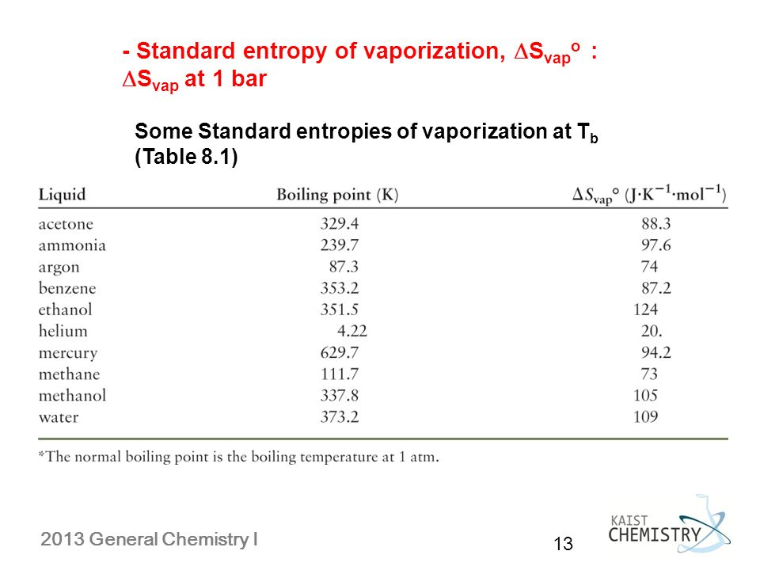
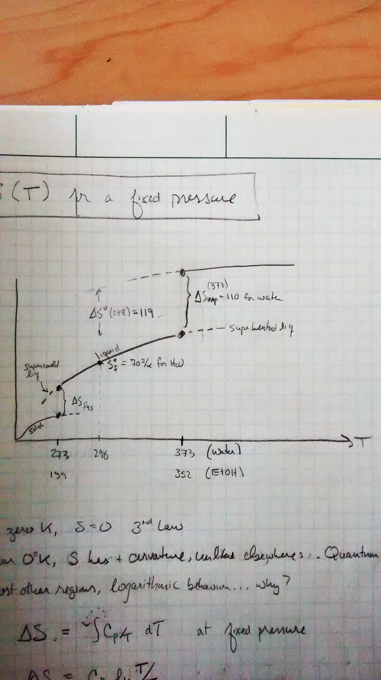
Summarizing some of these ideas
S
Standard state entropies of formation (from a table)
What Richard’s rule approximates (and some tables tell you precisely)
What Trouton’s rule approximates (and some tables tell you precisely)

Slide 6
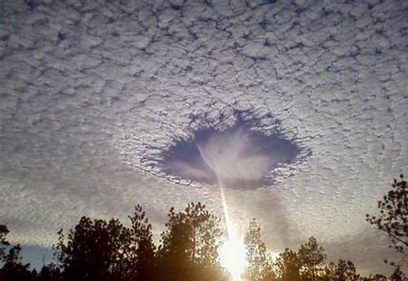
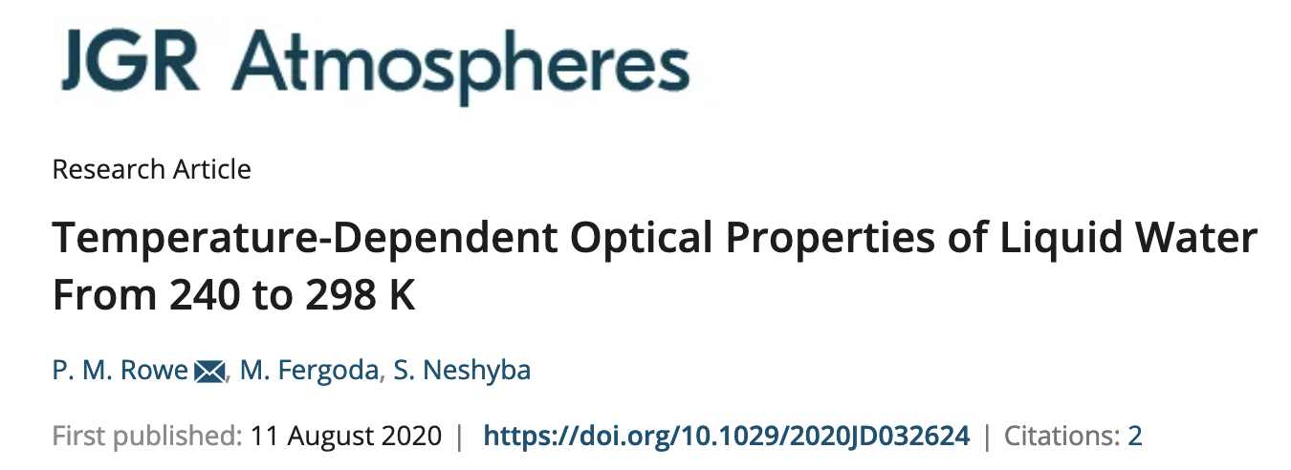
Supercooling and superheating
https://forum.xcitefun.net/punch-hole-clouds-layer-of-supercooled-clouds-t16564.html
S

